Slide 1

Your past, your present and your future

Slide 2


Slide 3
IDEA
What is Capsulefy?

Slide 4





Time capsule

Slide 5


Payment plans
 | Free | Premium
Price | 0 € | 11.99 €
Storage | 20 MB/user | 500 MB/capsule
Social network and email integration
Capsule scheduling | 1 year | No limit
Capsule expiration | 6 months after release | No expiration
Modular and private capsules

Slide 6
TECHNOLOGIES
What stack do we use?

Slide 7




Web app
Users and capsules
Media storage
Social network

Slide 8
COMPETITORS
What makes us different?

Slide 9
 | Viajeros en el tiempo | Mytimecapsule | Miigen | thetimecapsule | Capsulefy
Automatic content publication
Free plan
Premium plan
Images
Videos
Social network integration
Deadman switch

Slide 10
TEAM
Who is behind?

Slide 11
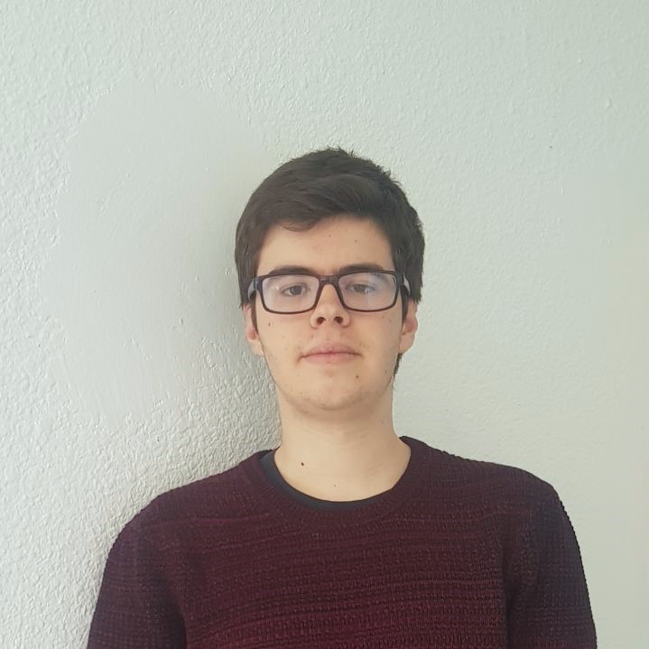
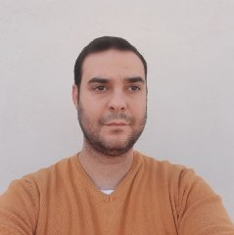




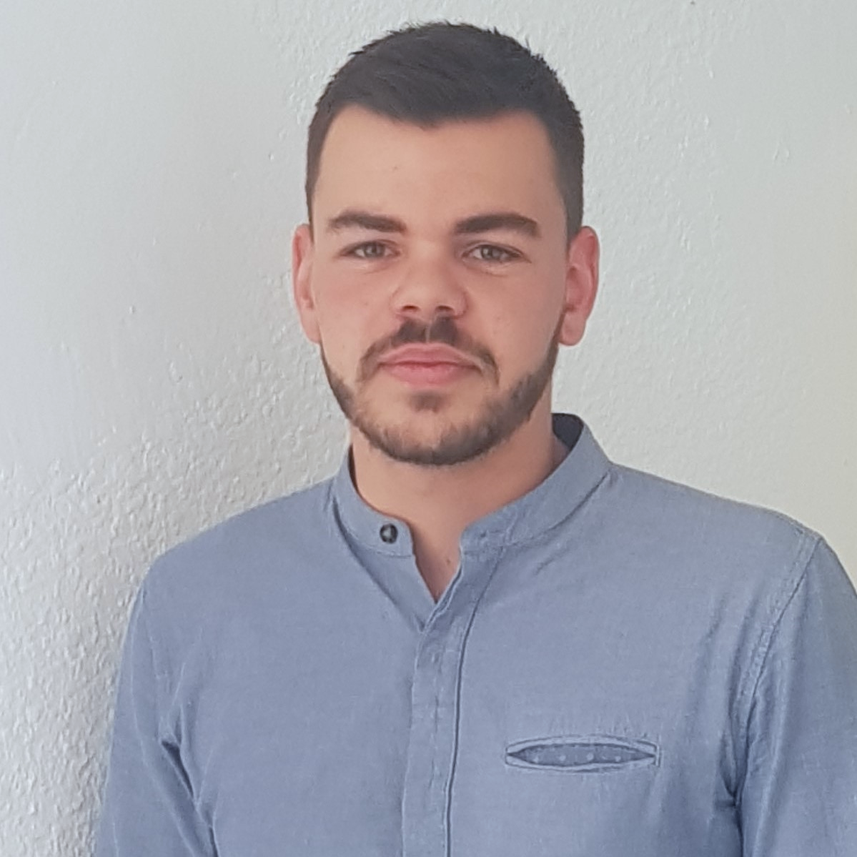
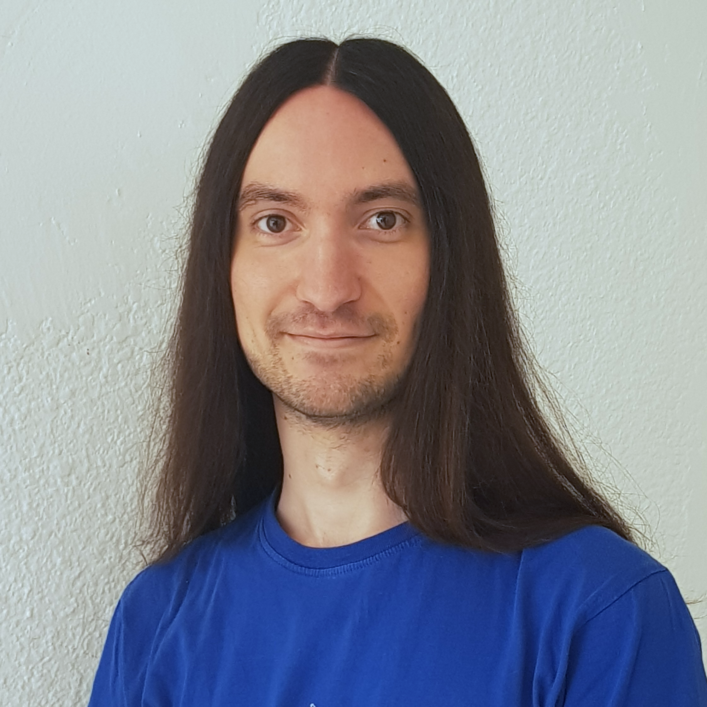


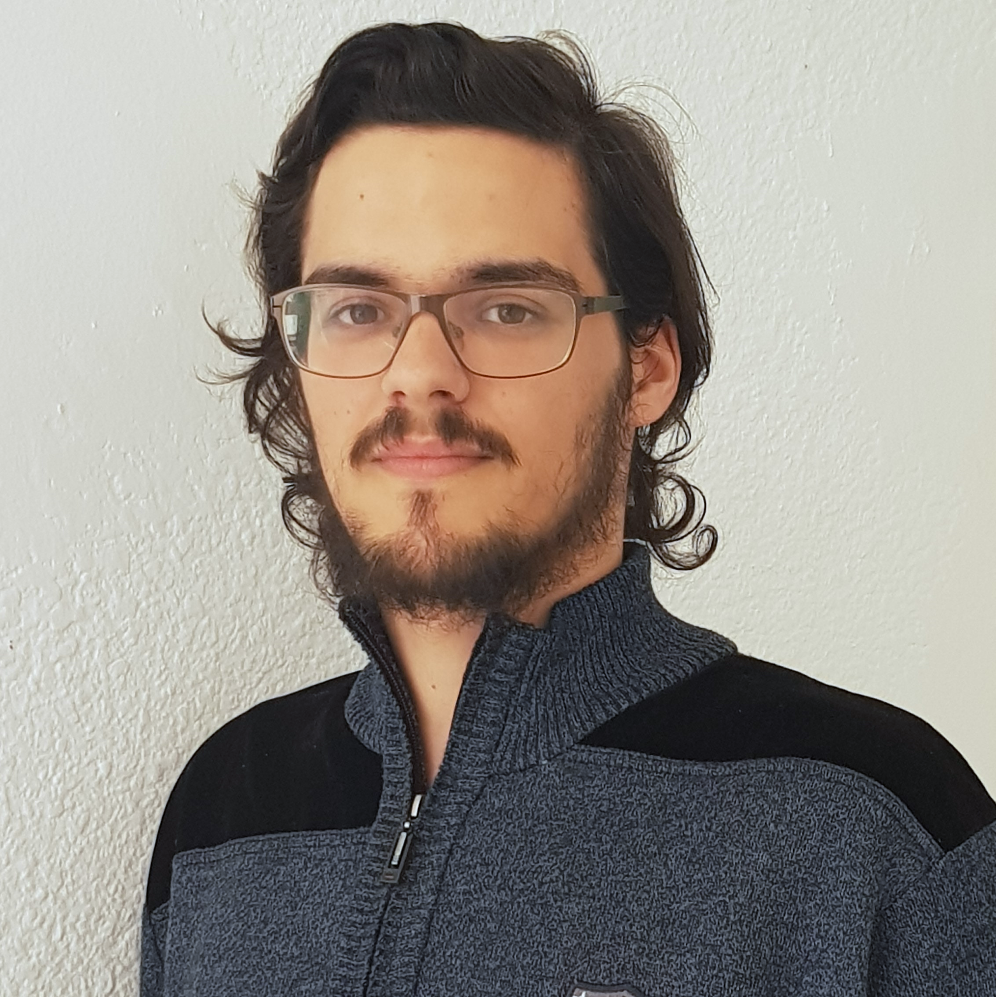



Pablo Rebollo
Project manager, backend developer
Juan Rodríguez
Requirements engineer, backend developer
Adrián Cantón
Business manager, full-stack developer
Rafael Fresno
Backend developer, API integration
Daniel Carpio
Analist,
frontend developer

Slide 12
COSTS
How much does Capsulefy cost?

Slide 13
Project duration | 4 months
Salaries | 20.80 €/hour
Hours per month | 40
Equipment | 306 €
Hosting, advertising and support | 18729 €
Risk prevention | 10% (2724 €)
Total | 44968 €

Slide 14



GDPR and measure calculation costs are included in the corresponding members’ salaries

Slide 15
DEMO
How does the system look like?

Slide 16
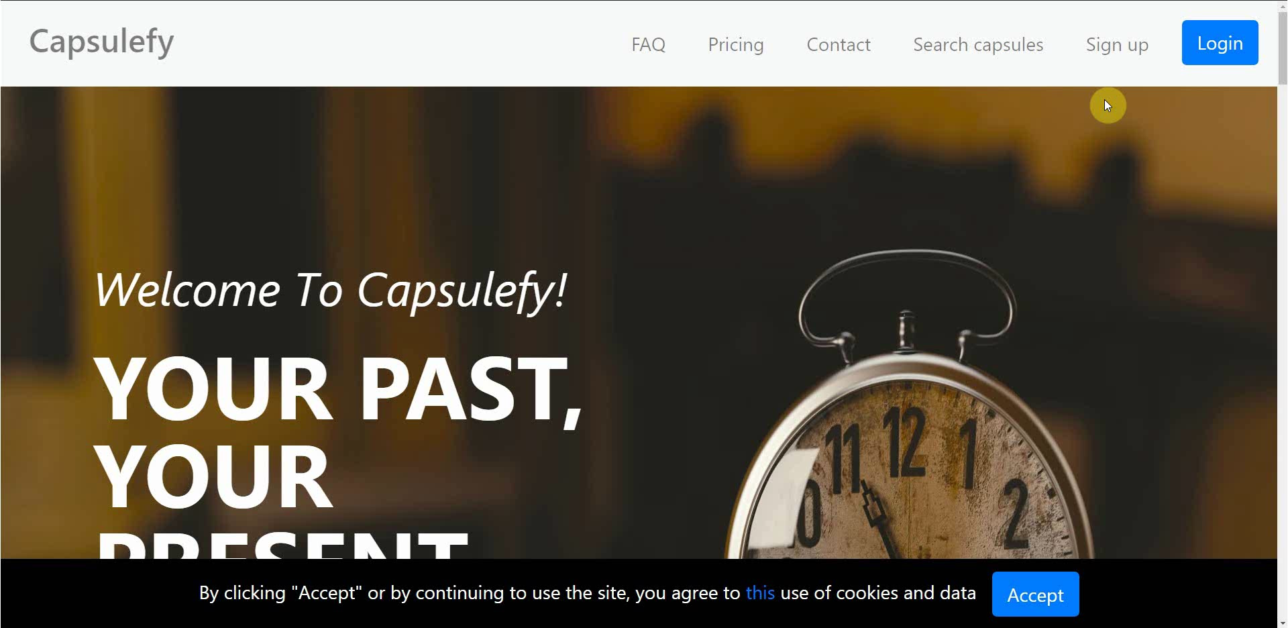
No logged user – Sign up

Slide 17
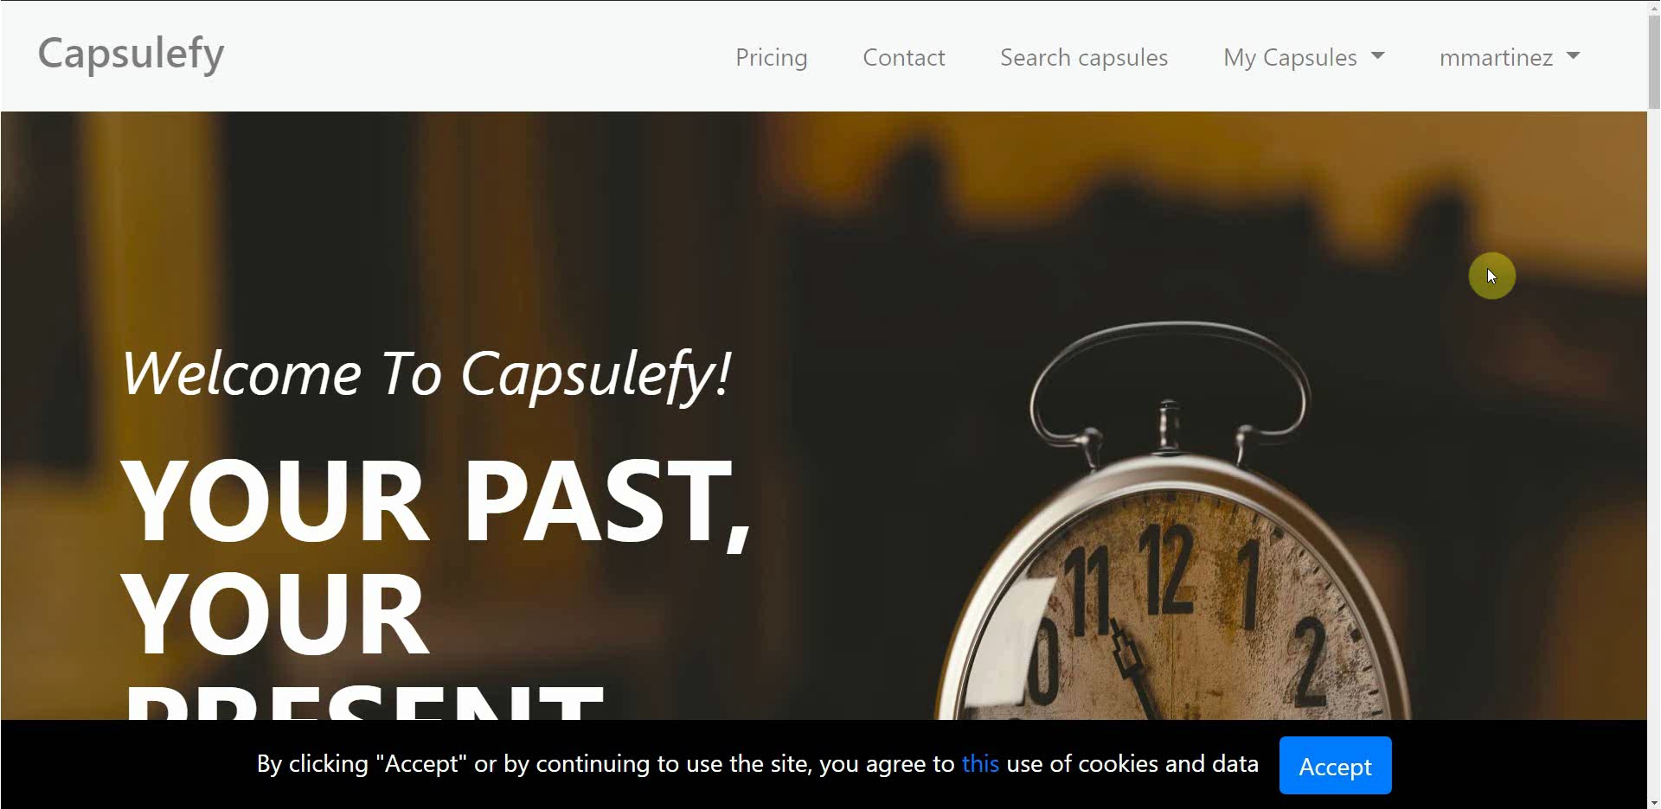
Logged-in user – Change password

Slide 18
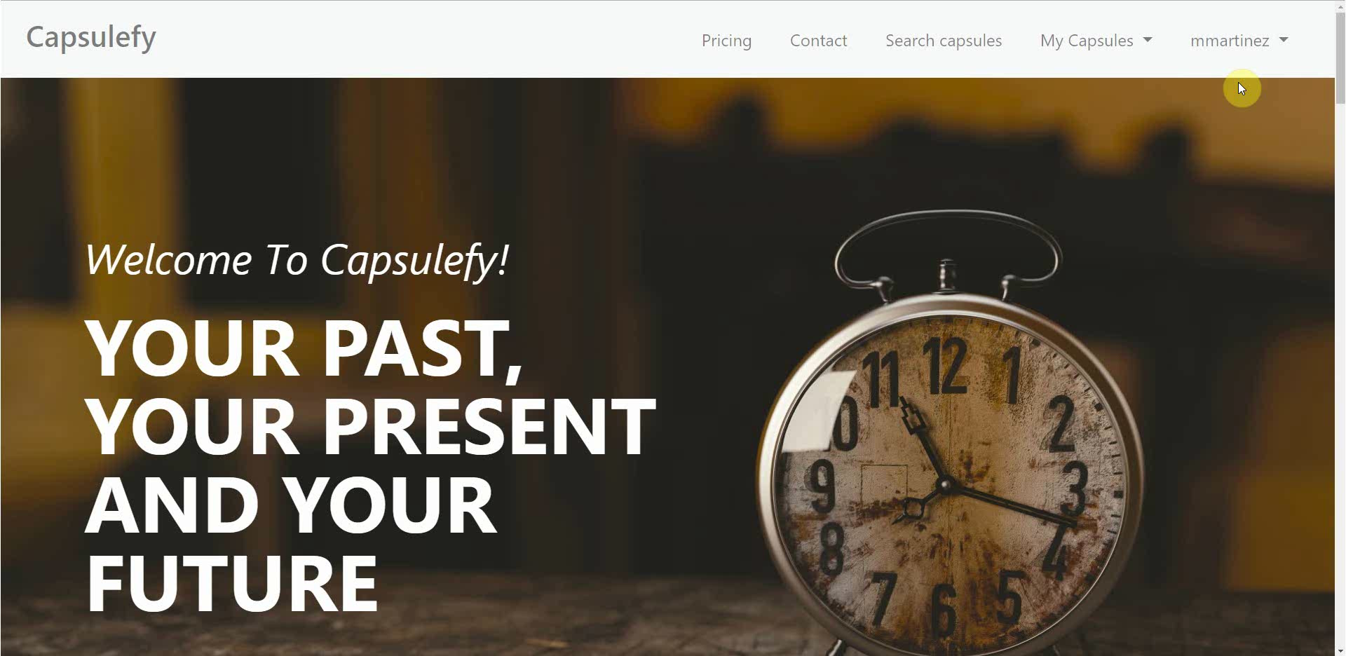
Logged-in user – Connect to Twitter

Slide 19
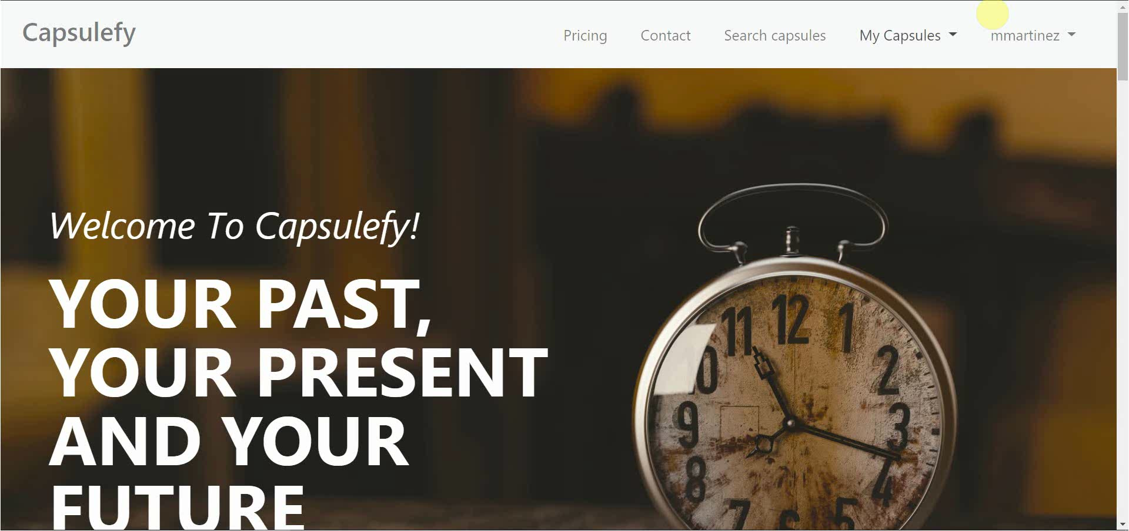
Logged-in user – Create and display capsule

Slide 20
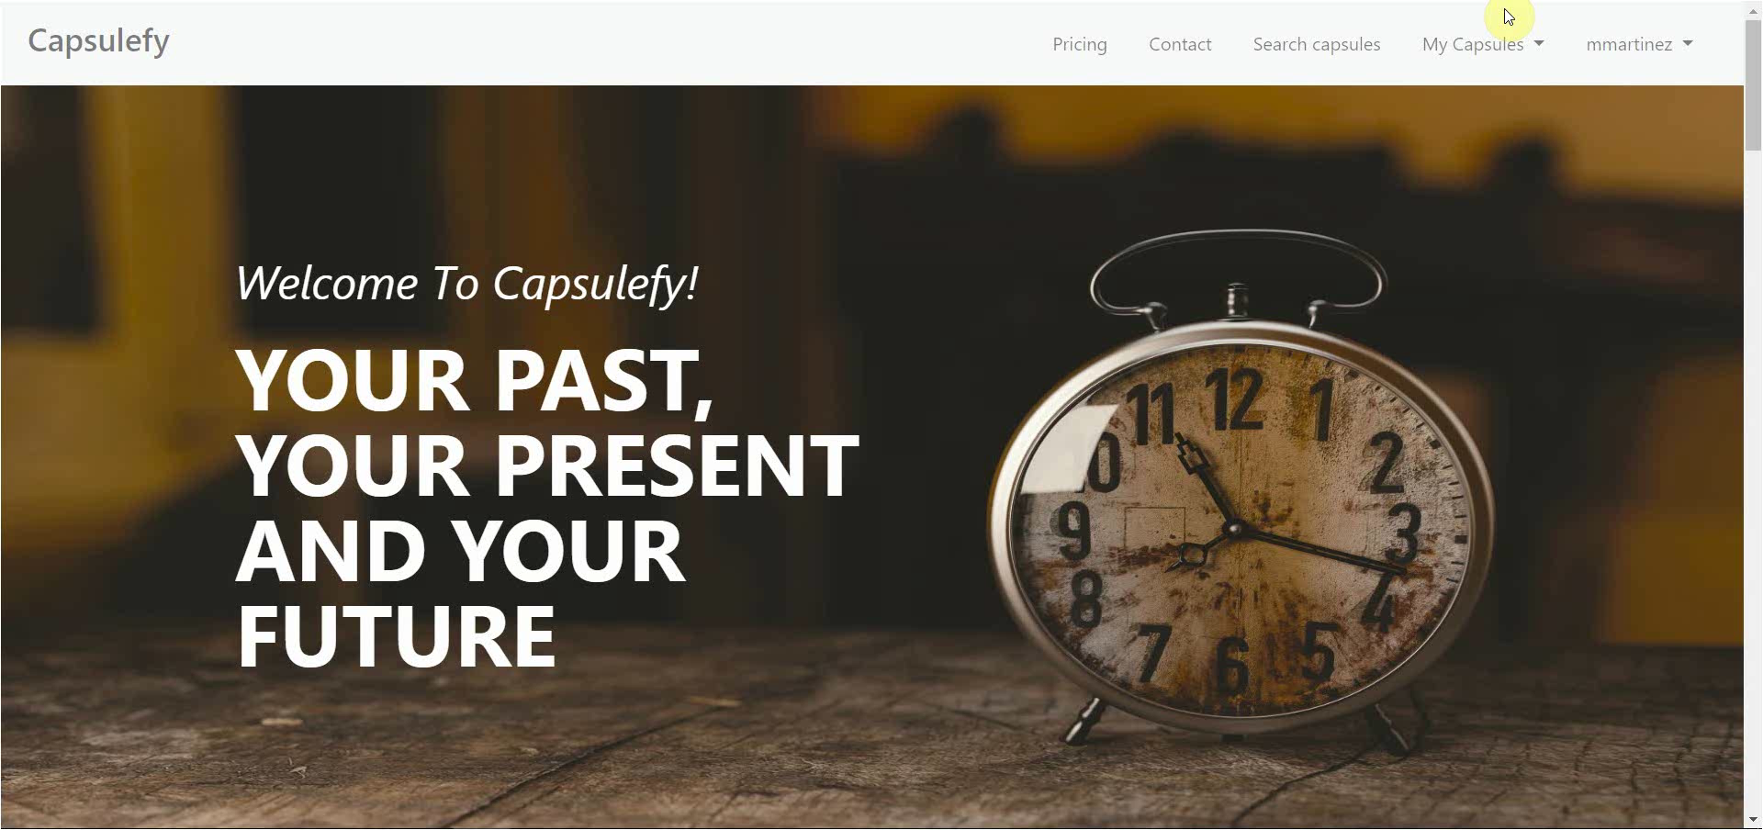
Logged-in user – Refresh timer

Slide 21

Logged-in user – Delete account

Slide 22
Thanks!
Upstream: https://capsulefy.herokuapp.com
Landing page: https://capsulefy01.herokuapp.com
Contact email: capsulefy.communications@gmail.com
GitHub releases: https://github.com/pabreblob/capsulefy/releases

Slide 23
GDPR
How do we comply with GDPR?

Slide 24

Users may delete their profile or capsules

Slide 25


Users can send an email to request unauthorized data deletion

Slide 26

Users will be prompted to reset their password if suspicious activity is detected

Slide 27


Users can send an email to retrieve all their stored data

Slide 28

All this information, including cookie usage, is available on our website

Slide 29


Users must agree to our terms of service before registering

Slide 30


What do we store?
Users:
- Full name
- Email
- Birthdate
- Notification email
- Social network token
Capsules:
- Content
- Files
- Emails
- Payment ID

Slide 31
Project launch Week 1
May 13th – May 19th

Slide 32
 |  | May
Task | Assignees | 13 | 14 | 15 | 16 | 17 | 18 | 19
Initial meeting | All
Social media accounts | Juan
Target groups | Pablo
StartUS tasks | Adrián
Advertisement spot | Daniel
Social media marketing | Juan
Marketing strategy | Pablo
Update landing page | Daniel

Slide 33
 |  | May
Task | Assignees | 13 | 14 | 15 | 16 | 17 | 18 | 19
Remake demo videos | Adrián
Update costs | Pablo
Carry out SM marketing | Juan
Review populate | Pablo
Presentation | Rafael
Rehearsal | Pablo

Slide 34
Target users
Who would use Capsulefy?

Slide 35




Target groups
Social media users
Families
People with income
Any gender

Slide 36




Our main user
Man or woman
Married
(or plans to be)
Strong family relationships
With kids
(or plans to have)

Slide 37



Why not elder people?
May be more attached to their family, but…
Less tech savvy

Slide 38



Why not younger people?
May be more familiar with technology, but…
Not much money and long term thinking

Slide 39
Marketing campaign
How are we advertising Capsulefy?

Slide 40




Social networks
Twitter
Facebook
Instagram
YouTube
LinkedIn
@capsulefy
Capsulefy Comms
Capsulefy Project

Slide 41
Social networks
Two adversisement spots available on YouTube
22nd May: first Twitter and Facebook publications (videos and text)
26th and 30th May, 3rd and 7th June: other publications (images, discounts…)

Slide 42

Monthly advertising costs
220 €
140 €
150 €

Slide 43
Discount campaigns
How are we promoting Capsulefy?

Slide 44



Discount campaigns
Free premium capsules during first week
20% discount during first month (8.99 €)
Referral system (during special dates)
%

Slide 45
Current costs
How are we managing costs?

Slide 46
Project duration | 12 weeks
Salaries | 11484
Equipment | 312 €
Hosting, advertising and support | 18729 €
Risk prevention | 10% (2724 €)
Total | 33249 €
Project completion | 85%
Spent budget | 73%
Total deviation | -3287 €

Slide 47
PILOTING PLAN
How are users testing Capsulefy?

Slide 48

Create manual
Create test suite
Test the system
Gather feedback
Fill form

Slide 49
Committed users
Name | Age
Francisco R. | 55
Javier A. | 19
Valentin A. | 19
Antonio G. | 26
José Manuel J. | 21
Name | Age
Sandra C. | 28
José Manuel C. | 21
Rafael C. | 55
Antonio C. | 54
Auxiliadora L. | 50

Slide 50
After development
Users receive and fill form
May 4 – May 12
Receive users feedback
May 12
Planification
May 13

Slide 51
Final FEEDBACK RESULTS
What did users say?

Slide 52

“It would be nice to be able to log in with Facebook”

Slide 53
“You could create some familiar plans or promotions”

Slide 54
“I miss some payment options other than PayPal”

Slide 55
“The deadmad timer could even be used for your own reminders”

Slide 56
“The interface is nice and clear. I did not experience any problem”

Slide 57
Project launch Week 2
May 20th – May 24th

Slide 58
 |  | May
Task | Assignees | 20 | 21 | 22 | 23 | 24 | 25 | 26
Feedback meeting | All
Improve ad spot | Daniel
Carry out SM marketing | Juan
StartUS posters | Juan
User interface feedback | Daniel
StartUS coord. tasks | Adrián
Deploy app | Adrián

Slide 59
 |  | May
Task | Assignees | 20 | 21 | 22 | 23 | 24 | 25 | 26
Test app | Daniel, Juan
Presentation | Rafael
Project launch doc | Pablo
Rehearsal | Pablo

Slide 60
Thanks!
Upstream: https://capsulefy.herokuapp.com
Landing page: https://capsulefy01.herokuapp.com
Contact email: capsulefy.communications@gmail.com
GitHub releases: https://github.com/pabreblob/capsulefy/releases

Slide 61


Deadman switch
ON

Slide 62




Teamwork
Skills
Profitable work
Positive feedback

Slide 63

Realistic | 44968 – 46330 €
Optimistic | 43061 €
Pesimistic | 49054 €
Project duration: 4 months

Slide 64




Risk | Mitigation
Broken computer | Risk prevention funds
Changing terms of use | Monitor
Servers down | Monitor
Incompatible timetables | Reschedule

Slide 65
Year 1: 2000 sales
Balance: -25168 €
Year 2: 4000 sales
Balance: 11441 €
44968 €
39600 €
28159 €
19800 €
Costs
Earnings
Costs
Earnings

Slide 66
Year 3: 8000 sales
Balance: 36450 €
79200 €
29023 €
Costs
Earnings

Slide 67


Slide 68
Sprint 2
Users receive and fill form
March 30 – April 6
Development
April 8 – April 12
Receive users feedback
April 6
Planification
April 8

Slide 69
Sprint 3
Easter Week
Users receive and fill form
April 12 – April 22
Development
April 22 – May 3
Receive users feedback
April 22
Planification
April 22

